Slide 1
Homework 1 Review
Discussion Section May 1st

Slide 2
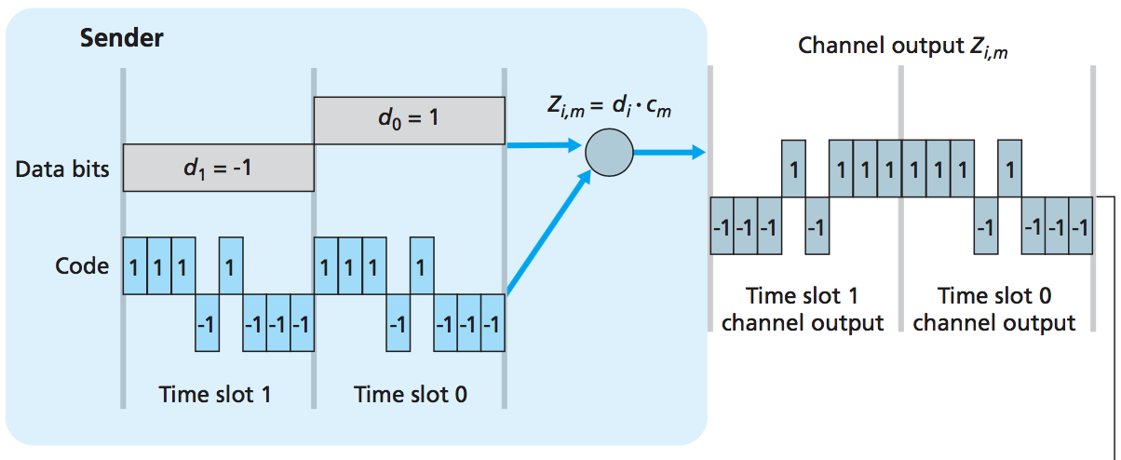
Homework 1 Review
Consider the single-sender CDMA example in the figure. What would be the sender’s output (for the 2 data bits shown) if the sender’s CDMA code were (1, -1, 1, -1, 1, -1, 1, 1)? Label the time slots d0 and d1.

Slide 3
Output corresponding to bit d₁ = (1, -1, 1, -1, 1, -1, 1, 1) x (-1) -> [-1,1,-1,1,-1,1,-1,-1]
Output corresponding to bit d₀ = (1, -1, 1, -1, 1, -1, 1, 1) x (1) -> [1,-1,1,-1,1,-1,1,1]

Slide 4
Suppose there are two ISPs providing WiFi access in a particular café, with each ISP operating its own AP and having its own IP address block.
Suppose that both ISPs have configured their APs to operate on channel 11. Will the 802.11 protocol completely break down in this situation? Discuss what happens when two stations, each associated with a different ISP, attempt to transmit at the same time.
APs -> Different SSIDs and MAC addresses
Collisions may happen
Since the channel is same, max aggregate data rate is 11Mbps (802.11b)
Client
A
B
Client

Slide 5
Now suppose that one AP operates on channel 1 and the other on channel 11. How do your answers change?
There won’t be any collisions, since they’re on different channels
Max. aggregate data rate is 22Mbp (802.11b)
Client
A
B
Client

Slide 6
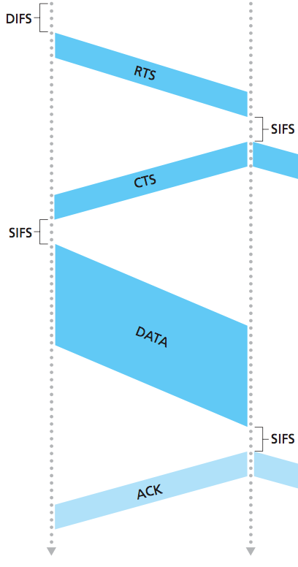
Suppose an 802.11b station is configured to always reserve the channel with the RTS/CTS sequence. Suppose this station suddenly wants to transmit 1000 bytes of data, and all other stations are idle at this time. The station will transmit at a data rate of 11Mbps. As a function of SIFS and DIFS, and ignoring propagation delay and assuming no bit errors, calculate the time required to transmit the frame and receive the acknowledgment.
Control frame (without data) = 32 bytes/256 bits (RTS, CTS, ACK)
Time to transmit = 256 bits/11Mbps = 23 µsec
Time to transmit data =8256 bits/11Mbps = 751 µsec
Total Time = DIFS + RTS + SIFS + CTS + SIFS + FRAME + SIFS + ACK
= DIFS + 3*SIFS + (3*23 + 751) µsec = DIFS + 3SIFS + 820 µsec

Slide 7
Consider the chaining example discussed at the end of Section 7.7.2 (chaining occurs when foreign networks are linked together, as opposed to updating the routing at the home network). Suppose a mobile user visits foreign networks A, B and C, and that a correspondent begins a connection to the mobile user when it is resident in foreign network A. Note that direct routing is used.
List the sequence of messages between foreign agents, and between foreign agents and the home agent as the mobile user moves from network A to network B to network C.
Now, suppose chaining is not performed, and the correspondent (as well as the home agent) must be explicitly notified of the changes in the mobile user’s care-of address. List the sequence of messages that would need to be exchanged in this scenario.

Slide 8
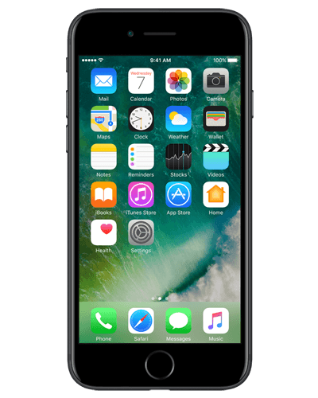
With Chaining: Concatenating foreign agents as they are visited
HA
A (FA)
B (FA)
C (FA)
A tells HA that mobile is in A

Slide 9
Chaining
HA
A (FA)
B (FA)
C (FA)
A tells HA that mobile is in A
B tells A that mobile is in B

Slide 10
Chaining
HA
A (FA)
B (FA)
C (FA)
A tells HA that mobile is in A
B tells A that mobile is in B
C tells B that mobile is in C *The HA only knows about hop to A

Slide 11
Without chaining: Routing changes propagated to HA
HA
A (FA)
B (FA)
C (FA)
A tells HA mobile is in A
B tells HA mobile is in B
B tells A mobile is in B (A tears down connection)

Slide 12
HA
A (FA)
B (FA)
C (FA)
A tells HA mobile is in A
B tells HA mobile is in B
B tells A mobile is in B (A tears down connection)
C tells HA mobile is in C
C tells B mobile is in C (B tears down connection)

Slide 13
Consider two mobile nodes in a foreign network with the same foreign agent. Is it possible for the two mobile nodes to use the same care-of address in mobile IP? Explain your answer.
Yes, it’s possible.
If the care-of-address is the address of the foreign agent, then this address would be the same. Once the foreign agent de-capsulates the tunneled datagram and determines the address of the mobile, then separate addresses would need to be used to send the datagrams separately to their different destinations (mobiles) within the visited net

Slide 14
A Bluetooth device can be in two piconets at the same time. Why can’t one device be the master in both of them at the same time?
A master can talk to only one slave at a time, which will reduce the scatternet to a piconet
Limited address space
Unique frequency hopping spread spectrum sequence.
Since the Master controls all the communication in a piconet, the BW will decrease by half

